Slide 1

Bug Bounty Journey: Exploring OWASP Top 10 Vulnerabilities
Tharindu Heshan Ranasinghe
IT23269484
Notes:
Good morning everyone! I’m Tharindu Heshan Ranasinghe, and I’m excited to share my bug bounty journey with you. This presentation, "Bug Bounty Journey: Exploring OWASP Top 10 Vulnerabilities," reflects my work testing 10 critical web security. I’ll walk you through my findings from 10 bug bounty reports, focusing on the OWASP Top 10, my experiences on HackerOne and Bugcrowd, and the lessons I’ve learned. I’ll also dive into specific scans using OWASP ZAP, Nikto, and Burp Suite, sharing their outputs to show how I uncovered these issues. Let’s get started!

Slide 2

Introduction
Objective: Share findings from 10 bug bounty reports on OWASP Top 10 vulnerabilities.
Bug Bounty: A way to enhance web security skills through ethical hacking.
Agenda: Summarize vulnerabilities, share bug bounty experience, highlight lessons, and reference videos.
Notes:
My goal was to analyze 10 bug bounty reports, each targeting an OWASP Top 10 vulnerability. Bug bounties are a fantastic way to sharpen security skills by ethically hacking real-world applications, helping organizations stay secure while we learn. Today, I’ll summarize the vulnerabilities, share my testing process—including detailed scan outputs from OWASP ZAP, Nikto, and Burp Suite—highlight key lessons, and reference a video reflection on my growth. The agenda is packed, so let’s dive into how I began this journey

Slide 3


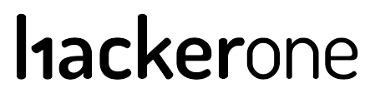
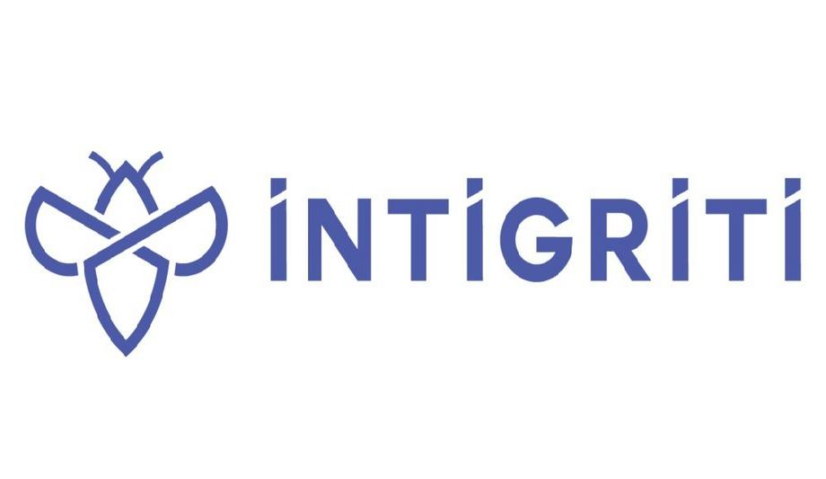

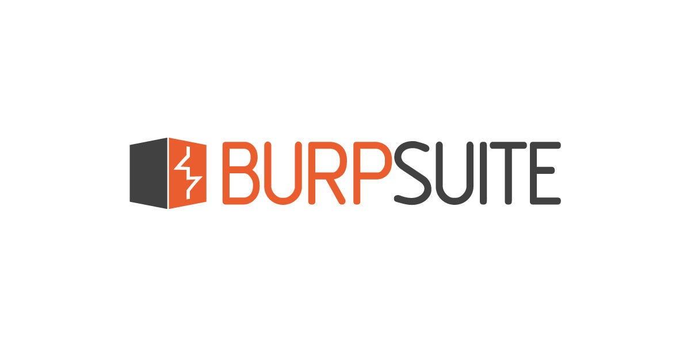

Getting Started with Bug Bounty
Platforms:
HackerOne
Bugcrowd
Intigriti
Tools used:
Burp Suite
OWASP ZAP
Nikto
Nmap
SQLMap
Notes:
Getting Started with Bug Bounty
Stepping into bug bounties was thrilling yet daunting. I chose HackerOne and Bugcrowd, and Intigiriti platforms that connect ethical hackers with organizations. My toolkit included Burp Suite for HTTP request manipulation, OWASP ZAP for automated scanning, Nikto for server reconnaissance, Nmap for discover hosts/services, detect open ports, and SQLMap for database testing

Slide 4

Skills:
Reconnaissance
Payload crafting
Vulnerability validation
Mindset:
Curiosity
Persistence
Ethical hacking principles
Notes:
These tools generated critical outputs that guided my findings, which I’ll share shortly. Success required skills like reconnaissance, payload crafting, and vulnerability validation, paired with a mindset of curiosity, persistence, and ethics. Bug bounties are about more than finding flaws they’re about making the internet safer.

Slide 5

Why Bug Bounty
Enhanced Security Posture
Cost-Effective Compared to Traditional Security
Rapid Vulnerability Discovery and Remediation
Reputation and Trust
Access to Global Talent
Continuous Testing
Notes:
Why Bug Bounty Why do companies embrace bug bounties? They enhance security posture, are cost-effective compared to traditional audits, and enable rapid vulnerability discovery. They build trust, tap global talent, and ensure continuous testing. For hackers, it’s a chance to test diverse systems and contribute to cybersecurity. Now, let’s explore the vulnerabilities, starting with detailed scan outputs for each.

Slide 6
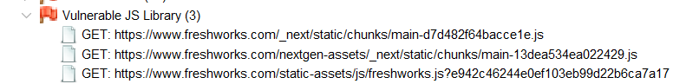
Outdated JavaScript Library www.freshworks.com
An outdated React.js library (v12.3.1) was detected using OWASP ZAP and Retire.js. This version is linked to known CVEs that could allow XSS, DOM manipulation, and client-side code execution.
Impact:
High risk of XSS
Data exposure
Client-side code execution
Risk Level : High
Notes:
First up, I found a high-risk issue on freshworks.com: an outdated React.js library detected using ZAP with the Retire.js plugin. The risk level was high, This version is tied to enabling attacks like Cross-Site Scripting (XSS), DOM manipulation, and client-side code execution.
A real-world example: a 2018 jQuery vulnerability led to data breaches on multiple sites due to outdated libraries.
The impact? XSS could steal session tokens, expose sensitive data, violate GDPR, and damage Freshworks’ reputation.

Slide 7
Steps to Reproduce:
Configure OWASP ZAP proxy (localhost:8081)
Navigate to freshworks.com and scan
Retire.js flags React v12.3.1
Mitigation:
Upgrade to latest React.
Use sub resource Integrity.
Implement strict CSP (strict-src ‘self’)
Notes:
Here’s how I found it: I configured ZAP as a proxy on localhost, navigated to freshworks.com, and let ZAP passively scan. The output was clear:
ZAP Alert: “Vulnerable JS Library Detected”
To cross-check, I ran a Nikto scan, which revealed:
Output: “No X-Frame-Options, X-Content-Type-Options, or HSTS headers detected.”
This lack of headers amplified the risk, as attackers could chain XSS with other exploits. Burp Suite’s passive scan confirmed the library in loaded scripts.
Mitigation steps included: Upgrade to the latest React, Use Subresource Integrity (SRI), Add a strict CSP, Enable headers
This taught me that outdated dependencies are a silent threat.
Next, let’s look at SQL injection.

Slide 8
SQL Injection
.
www.urbanDictionary.com
SQL injection exploits vulnerabilities to manipulate databases with malicious SQL code.
SQL injection testing was performed using SQLMap, Burpsuite, and OWASP ZAP on the search.php?term= parameter.
Impact: No vulnerabilities found, indicating secure database handling
Database exposure
Account takeover
Full db read/ write access
Application compromise
Risk Level : High
Notes:
SQL injection is a critical vulnerability where attackers manipulate database queries via unsanitized inputs On urbandictionary.com, I tested the search.php?term= parameter with SQLMap, Burp Suite, and OWASP ZAP. no vulnerabilities were found! The database is secure.
But if there were issues, it could lead to big problems: data leaks, account takeovers, full database access, or even app compromise. That’s why the risk level is high. as seen in a 2017 SQL injection attack on a forum that leaked thousands of accounts.

Slide 9
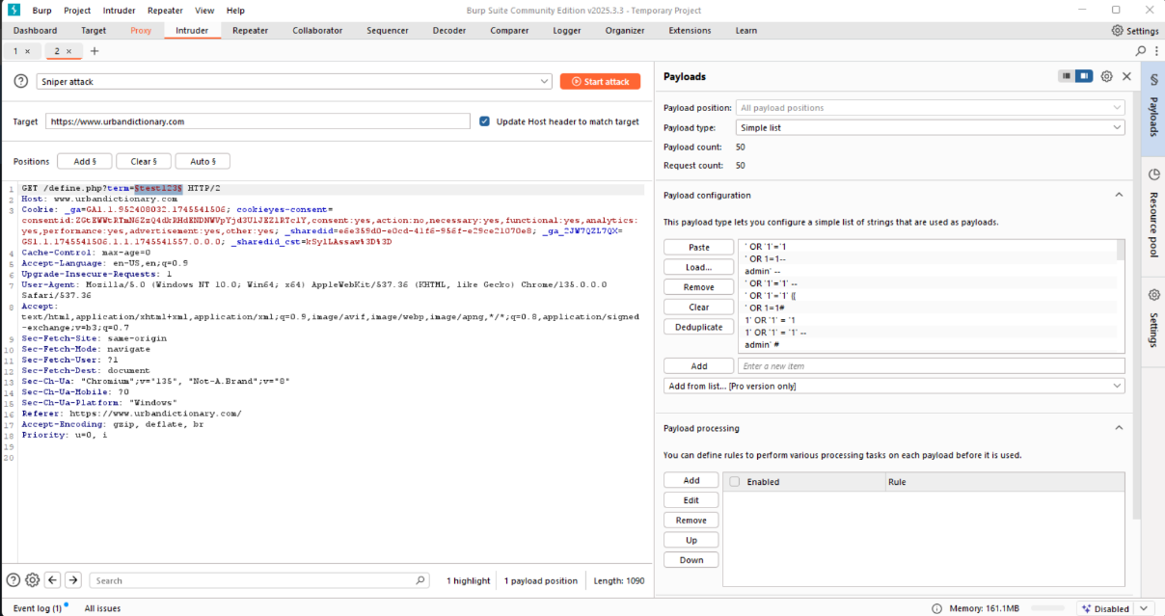
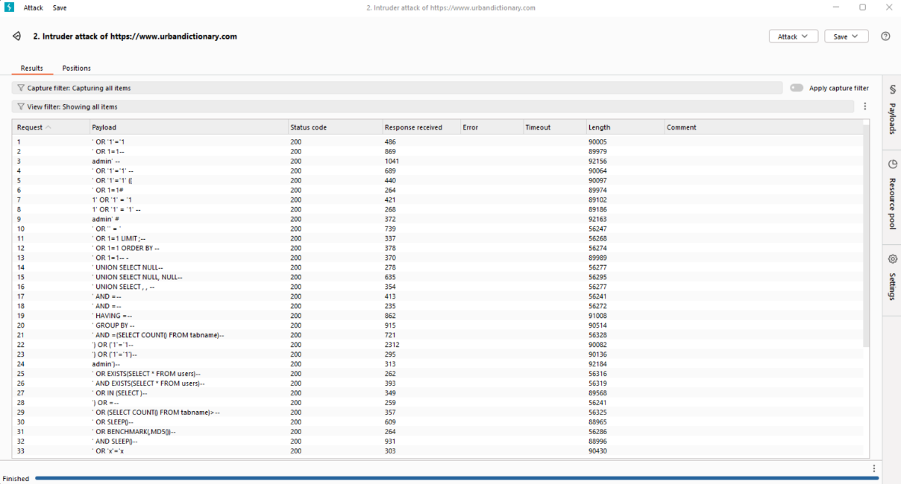
Loaded 50 SQL injection payloads in the "Payloads" tab
Executed the attack and analyzed the results in the "Results" tab.
All 50 requests returned HTTP 200 status codes with expected response lengths (859 to 90430 bytes).
No delays, SQL errors, or unexpected data were observed, indicating no SQL injection vulnerabilities.
Notes:
used Burp Suite’s Intruder tool to test for vulnerabilities. Here’s what I did: I loaded 50 SQL Injection payloads in the "Payloads" tab and then executed the attack. After that, I analyzed the results in the "Results" tab.
The outcome? All 50 requests returned HTTP 200 status codes, exactly what we’d expect. There were no delays, no SQL errors, and no unexpected data. This clearly shows there are no SQL Injection vulnerabilities on this site.
That’s a great result, proving the website’s database is well-protected

Slide 10
Steps to Reproduce:
OWASP ZAP scan on search.php?term=test
Burp Suite with 50 SQL payloads
SQLMap automated testing
Mitigation:
Use parameterized queries.
Implement input validation.
Employ WAF and logging.
Notes:
Other Scan outputs were telling:
OWASP ZAP: No SQL injection alerts; flagged minor issues like missing Anti-CSRF tokens.
Nikto: “Missing headers: X-Frame-Options, Strict-Transport-Security. No SQL injection vulnerabilities.”
SQLMap: “No injectable parameters detected” after testing Boolean, error, UNION, and time-based techniques.
Mitigation included continuing parameterized queries, adding input validation, and deploying a Web Application Firewall (WAF). This showed me that robust coding practices can neutralize severe threats.
Let’s move to missing CSP and clickjacking.

Slide 11
Missing CSP & Clickjacking
www.basecamp.com
Missing Content-Security-Policy and X-Frame-Options headers allow framing, increasing the risk of XSS and clickjacking attacks where malicious sites can embed the page in iframes to trick users.
Impact:
Clickjacking via iframe overlays
Third-party script injection
Bypass of iframe-based protections
Risk Level : Medium
Notes:
On basecamp.com, I found missing Content-Security-Policy (CSP) and X-Frame-Options headers, increasing risks of clickjacking and XSS. Clickjacking tricks users into clicking hidden elements via iframes, while a missing CSP allows malicious scripts. The risk was medium, as the tested page was static, but chaining with other flaws could escalate attacks.
A real-world case: a 2019 clickjacking attack on a banking site tricked users into transferring funds

Slide 12
Steps to Reproduce:
OWASP ZAP passive scan
Nikto confirms missing headers
iframe test confirms frameable page
Mitigation:
Add CSP: default-src 'self'; script-src 'self'; frame-ancestors 'none'
Set X-Frame-Options: DENY
Use Mozilla Observatory to verify header presence
Notes:
Scan outputs confirmed the issue:
OWASP ZAP: “Alert: Missing Content-Security-Policy and X-Frame-Options headers.”
Nikto: “No CSP or X-Frame-Options headers; Cloudflare detected.”
Burp Suite: HTTP history showed the page was frameable in an iframe test.
To reproduce, I ran ZAP’s passive scan, used Nikto, and created an iframe PoC:
The page loaded, confirming frameability.
Mitigation included:
Add CSP: Content-Security-Policy: default-src 'self'; frame-ancestors 'none'.
Set X-Frame-Options: DENY.
Verify with Mozilla Observatory.
This highlighted how simple header omissions create exploitable gaps.
Next, let’s explore path traversal.

Slide 13
Path Traversal
www.kiwi.com
Path traversal is a vulnerability that allows attackers to access files and directories outside the intended web root by manipulating input paths.
Tested endpoints with payloads like ../../etc/passwd. Application safely handled inputs no LFI/Directory Traversal observed.
Impact:
Reading server config or user data
Code execution via local file include
Credential leaks
Notes:
Path traversal is a vulnerability that allows attackers to access files and directories outside the intended web root by manipulating input paths.
Path traversal allows attackers to access files like /etc/passwd using inputs like ../. On kiwi.com, I tested endpoints with Burp Suite’s Intruder, using payloads like ../../etc/passwd. No vulnerabilities were found, indicating strong input validation and directory controls
If vulnerable, attackers could’ve leaked credentials or executed code, as seen in a 2020 path traversal exploit on a travel site exposing booking data

Slide 14
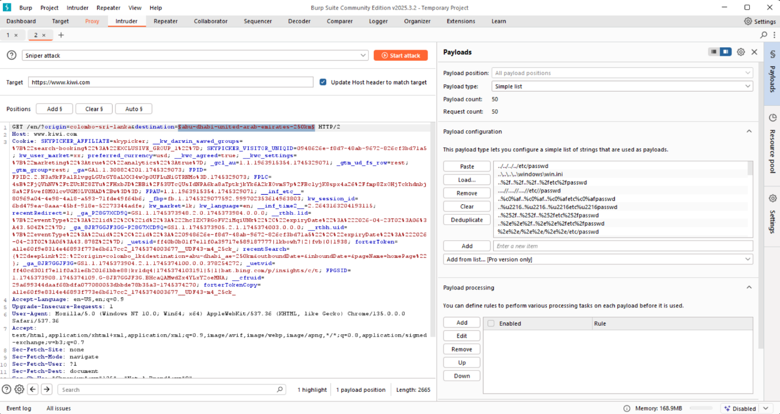
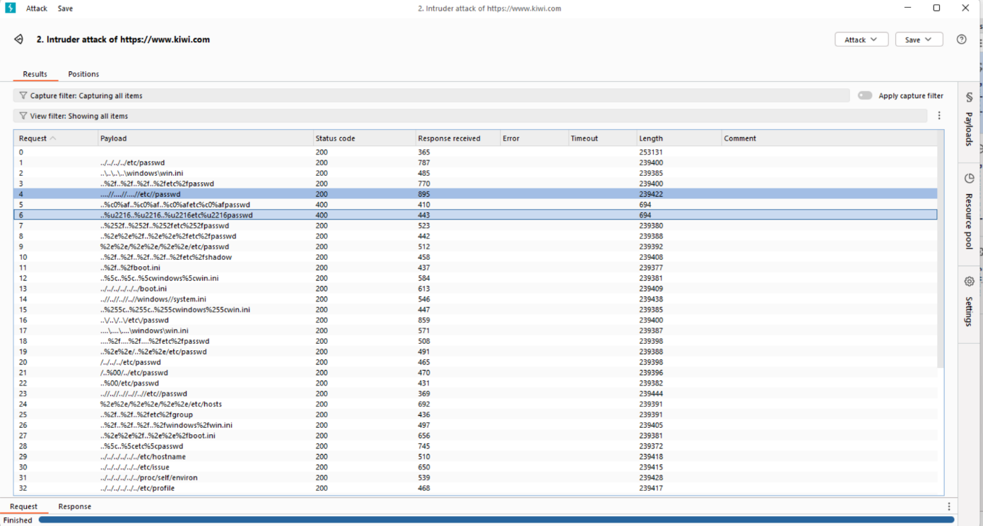
The highlighted request includes a path with suspicious parameters (abu-dhabi-united-arab-emirates-250km).
200 for all payloads; consistent response lengths, no sensitive data.
Notes:
I used Burp Intruder to test this endpoint, sending payloads see if I could access restricted files. The result? All payloads got an HTTP 200 status, with consistent response lengths and no sensitive data exposed. but the site’s defenses held strong!

Slide 15
Risk Level : High
Steps to Reproduce:
Mitigation:
Use Burp Intruder with payloads (../, %2e%2e)
Analyze status codes and response bodies
Confirm normal behavior
Sanitize inputs
Use allowlist for path values
Use realpath() or os.path.abspath() for validation
Notes:
Other Outputs were consistent:
OWASP ZAP: “No path traversal vulnerabilities; minor header issues noted.”
Nikto: “No evidence of file disclosures or directory traversal.”
Mitigation included using realpath() or os.path.abspath() and restricting file access. This reinforced the importance of sanitizing user inputs.
Let’s move to PII disclosure.

Slide 16
PII Disclosure
www.hemi.xyz
PII disclosure exposes personal data like names or emails, risking privacy and identity theft.
Discovered personal information in blog HTML responses. Weak/missing CSP increases attack risk.
Impact:
Identity theft
Legal penalties (e.g., GDPR fines)
Phishing and spam risks
Increased chance of XSS
Notes:
PII disclosure exposes personal data like names or emails, risking privacy and identity theft.
On hemi.xyz, a HackerOne program, I discovered Personally Identifiable Information (PII) names and emails in blog HTML responses, worsened by a weak or missing CSP. This high-risk issue risked identity theft, GDPR fines, Legal penalties and increased XSS attacks.

Slide 17
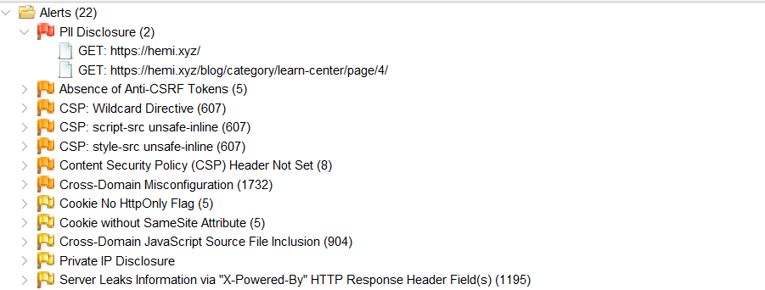
Risk Level : High
Mitigation:
Sanitize server responses
Add strict CSP
Hide sensitive data in public endpoints
Harden cookies with HttpOnly, Secure, SameSite
Notes:
Outputs highlighted the severity:
OWASP ZAP: “Alert: PII disclosure in a webpage
Nikto: shows “Missing headers: X-Content-Type-Options, X-Frame-Options; WP Engine detected.”
Burp Suite: Proxy captured PII in responses; no CSP restrictions.
To reproduce, I visited blog pages, searched source for PII, and ran curl on https://hemi.xyz, confirming missing headers. A 2021 data leak on a social platform exposed millions of emails due to similar PII disclosure. Mitigation included:
• Data Minimization
• Encryption
• Access Controls:
• Input Validation
• Logging and Monitorin.
• Regular Security Audits
.
Next, let’s discuss Commannd Injection vulnerability.

Slide 18
Command Injection
www.audible.com
Tested for Command Injection vulnerabilities using Nmap, Nikto, OWASP ZAP, and Burp Suite with 100 payloads (e.g., "; ls", "cat /etc/passwd") on input fields and API endpoints.
Impact:
Server takeover
Data theft (e.g., sensitive files)
Website damage
Unauthorized access
Risk Level: High
Notes:
Command injection is a type of security vulnerability where an attacker can execute arbitrary commands on a host system by injecting malicious input into a vulnerable application. This vulnerability was tested using tools like Nmap, Nikto, OWASP ZAP, and Burp Suite, with 100 different payloads—such as simple commands injected into input fields and API endpoints. The impact is alarming: server takeover, data theft of sensitive files, website damage, and unauthorized access. The risk level is marked as high, and for a platform like this, that’s a wake-up call. Command injection happens when unvalidated user input is executed as a system command, allowing attackers to run malicious code and potentially take over the entire system.

Slide 19
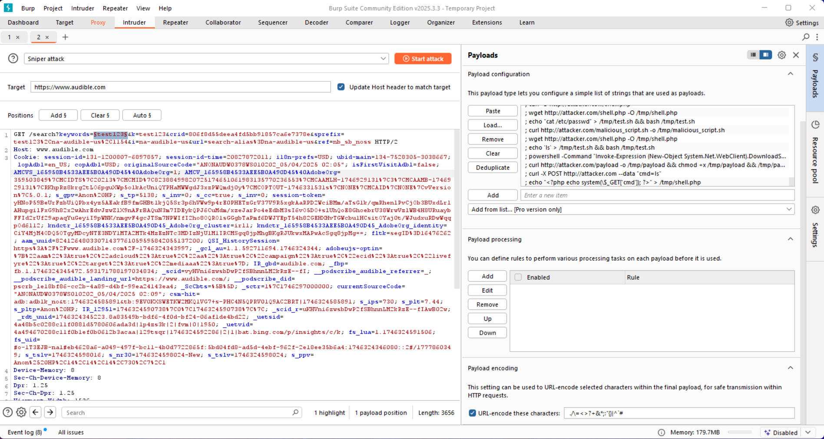
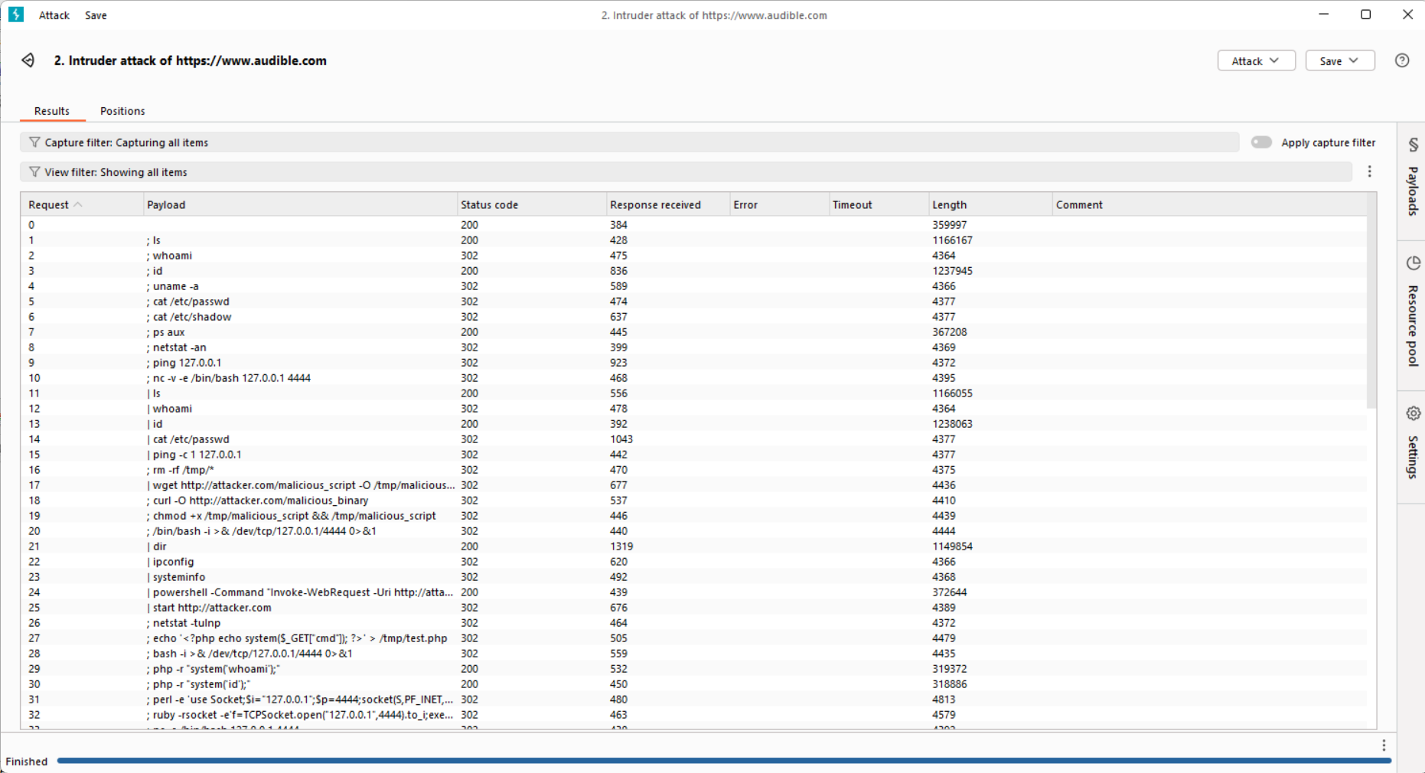
Tested with 100 Command Injection payloads on the search bar and APIs.
Checked results, no payloads worked, all got 403 or 200 responses.
Notes:
The testing involved injecting 100 command injection payloads into the website’s search bar and APIs. The results? None of the payloads succeeded—all returned either a 403 Forbidden or a 200 OK response, indicating the system either blocked the request or didn’t execute the command. This is a good sign, showing that some defenses are in place, possibly input validation or a web application firewall.

Slide 20
Steps to Reproduce:
Intercept search request (/search?keywords=test123) with Burp Suite Proxy
Send to Intruder, mark keywords parameter, load 100 payloads, and analyze responses (all returned 200 or 403)
Verify with Nmap (ports 80, 443 open), Nikto, and OWASP ZAP scans
Mitigation:
Validate and sanitize all inputs
Avoid system calls (e.g., system(), exec())
Use safe APIs and limit server permissions
Add CSP header for additional security
Notes:
To reproduce, one would intercept a search request using Burp Suite Proxy, inject payloads into parameters like the "keywords" field, and analyze responses with tools like Nmap and OWASP ZAP. But the mitigation steps are what we should focus on: validate and sanitize all user inputs, avoid using risky system calls like system() or exec(), use safe APIs, limit server permissions, and add a Content Security Policy (CSP) header for extra protection. These steps can significantly reduce the risk of command injection attacks.
Next, let’s cover Cross site scripting vulnerability.

Slide 21
XSS – Cross Site Scripting
www.mars.com
XSS (Cross-Site Scripting) is a vulnerability that allows attackers to inject malicious scripts into web pages viewed by other users, enabling data theft or session hijacking.
Tested Reflected, Stored, and DOM-based XSS using 100 payloads via Burp Suite and ZAP. All input was sanitized.
Impact:
Cookie theft
Session hijacking
Website defacement
Phishing redirection
Notes:
Cross-Site Scripting is a vulnerability that allows attackers to inject malicious scripts into web pages viewed by other users. This can lead to severe consequences, such as cookie theft, session hijacking, website defacement, and phishing redirection. The image highlights a test conducted on a website using tools like Burp Suite and OWASP ZAP, with 100 XSS payloads. Fortunately, all input was sanitized, meaning the website blocked the malicious scripts. However, the potential impact of a successful XSS attack is significant attackers could steal user data or take over accounts, making it a high-risk issue we must address.

Slide 22
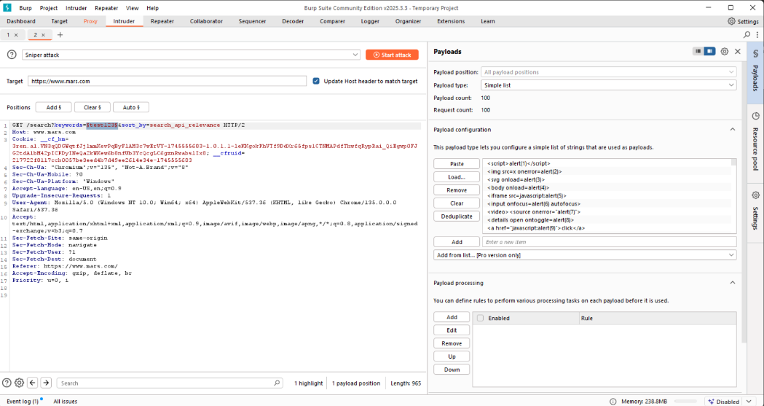
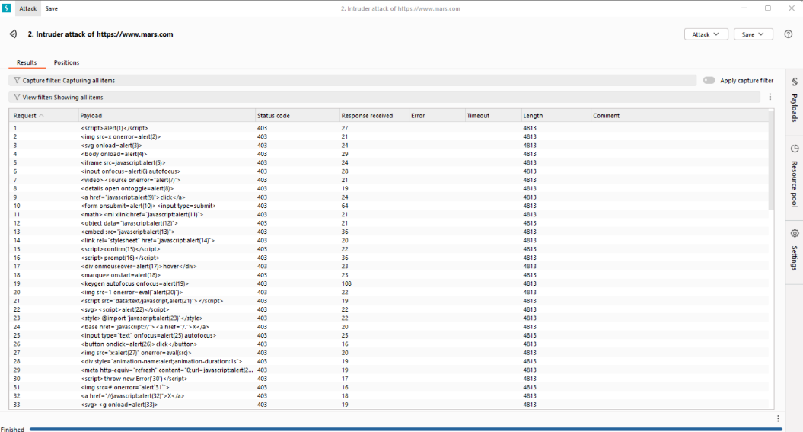
In the "Payloads" tab, loaded 100 XSS payloads.
Checked results no payloads worked, all got 403 or 200 responses
Notes:
The test loaded 100 XSS payloads in the "Payloads" tab of a tool, likely Burp Suite, targeting the website’s input fields, such as search bars. The results? None of the payloads worked all attempts received either a 403 Forbidden or 200 OK response, indicating the scripts were either blocked or didn’t execute.

Slide 23
Risk Level : High
Steps to Reproduce:
Use Burp Intruder on inputs like search
Load payloads like <script>alert(1)</script>
Confirm script is blocked or escaped.
Mitigation
Input validation and sanitization
Output encoding
Use Content Security Policy (CSP)
Use HTTPOnly and Secure cookies
Avoid eval() and similar functions
Notes:
To reproduce, one would use Burp Intruder to inject payloads into input fields and check if the script executes or is escaped. The mitigation strategies are key: implement input validation and sanitization to block malicious scripts, use output encoding to ensure data is safely rendered, apply a Content Security Policy (CSP) to restrict script execution, use HTTPOnly and Secure cookies to protect session data, and avoid risky functions like eval(). These steps can significantly reduce the risk of XSS attacks.
Next, let’s cover Hash Disclosure vulnerability

Slide 24
Hash Disclosure
www.redis.io
Hash disclosure is when a system unintentionally reveals hashed data (e.g., passwords or tokens), which attackers can attempt to crack to gain sensitive information.
BCrypt hashes ($2a$...) found in public tutorials. Though likely examples, they should not be publicly visible.
Risk Level : High
Impact:
Brute-force attempts
Training adversarial ML models
Reveals internal system patterns
Notes:
Hash disclosure occurs when a system unintentionally reveals hashed data, such as passwords or tokens. Attackers can use these hashes to attempt cracking them and gain access to sensitive information. For example, BCrypt hashes, often found in public tutorials with identifiers like "$2a$...", are common examples. While useful for learning, these should never be publicly visible due to the risks they pose.
The risk level here is high. The impact includes brute-force attempts, where attackers systematically guess the original data. It also enables training adversarial machine learning models to predict patterns and reveals internal system behaviors, giving attackers valuable insights.

Slide 25
Steps to Reproduce:
Visit Redis tutorials
Ctrl+F for $2a$
Confirm full hashes in code samples
Mitigation :
Avoid exposing hash values in URLs, HTML, or error messages
Use strong hashing algorithms like bcrypt or Argon2
Store hashes securely on the server side only
Implement proper access controls
Notes:
So, how does this happen? You can reproduce it by visiting Redis tutorials, using Ctrl+F to search for "$2a$", and confirming full hashes in code samples. To mitigate this, avoid exposing hash values in URLs, HTML, or error messages. Use strong hashing algorithms like BCrypt or Argon2, store hashes securely on the server side only, and implement proper access controls.

Slide 26
Insecure DOR
www.zabbix.com
IDOR occurs when attackers access unauthorized resources by manipulating input parameters.
2000+ ID values tested manually via Burp. No unauthorized data was returned good access control confirmed.
Risk Level : High
Impact:
No vulnerabilities found, strong access controls
Unauthorized access to accounts/data
Data leaks
Escalation to admin privilege
Notes:
Insecure DOR happens when attackers access resources by manipulating input parameters, like user IDs. In a test on Zabbix, over 2000 ID values were manually checked using Burp Intruder. The good news? No unauthorized data was returned, confirming strong access controls. However, the risk level remains high because if IDOR vulnerabilities exist, they can lead to severe consequences.
The potential impact is significant. IDOR can lead to unauthorized access to accounts or data, cause data leaks, or even allow escalation to admin privileges. These outcomes can compromise entire systems and expose sensitive information.

Slide 27
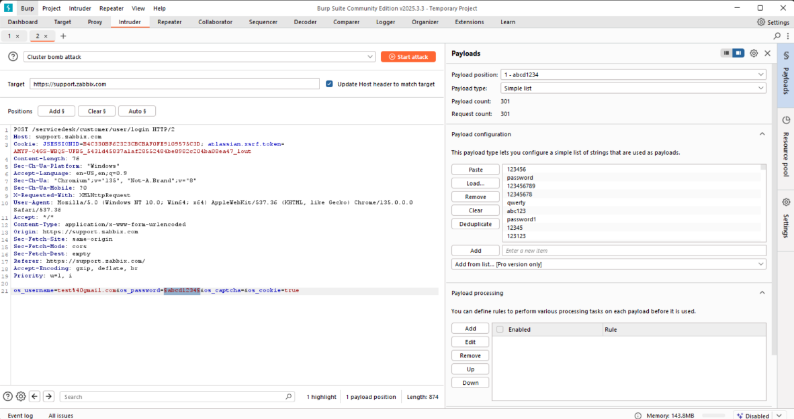
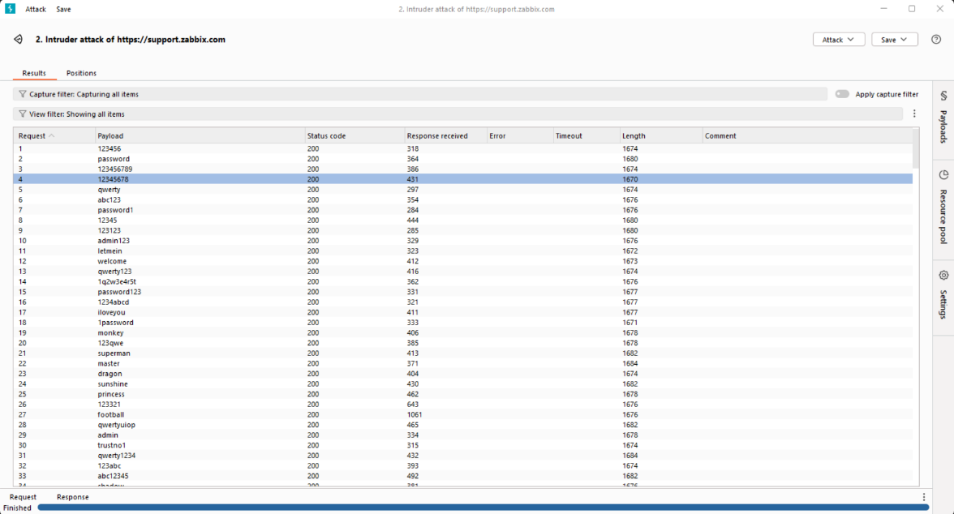
The Burp Suite Intruder tool was configured to test the /servicedesk/customer/user/login endpoint with 2000 payloads
An HTTP 200 status code means "OK," indicating that the server successfully processed the request and returned the expected response.
2000 payloads did not reveal any IDOR vulnerabilities
Notes:
Here’s how it was tested. The Burp Intruder tool targeted the /servicedesk/customer/user/login endpoint, testing 2000 payloads on the user ID parameter. An HTTP 200 status code indicated the server processed the request successfully, but in this case, no IDOR vulnerabilities were found, as only authorized data was returned.

Slide 28
Steps to Reproduce:
Use Burp Intruder on user ID parameter
Test ID ranges (1–2000)
Confirm only authorized data is shown
Mitigation:
Use per-user access checks on backend
Avoid predictable IDs
Enforce authorization for all endpoints
Notes:
To reproduce IDOR, use Burp Intruder on a user ID parameter, test ID ranges from 1 to 2000, and confirm if unauthorized data is shown. To mitigate, implement per-user access checks on the backend, avoid predictable IDs, and enforce authentication across all endpoints.
while this test showed strong controls, IDOR remains a high-risk vulnerability. By following these mitigation steps, we can prevent unauthorized access and protect our systems.
Next, Let’s move onto the Anti- CSRF-Token

Slide 29
Anti-CSRF Tokens
www.Heroku.com
Anti-CSRF in a site involves using unique tokens to validate requests, ensuring that they are initiated by the authenticated user and not by a malicious attacker.
Newsletter form lacks anti-CSRF tokens. A CSRF attack could submit the form without user consent.
Risk Level : Medium
Impact:
Forced subscriptions
More serious actions if reused in authenticated contexts
Undermines user trust
Notes:
Anti-CSRF tokens are unique tokens used to validate requests, ensuring they’re initiated by authenticated users and not malicious attackers. On Heroku, a newsletter form was found lacking these tokens. Without them, a CSRF attack could submit the form without user consent, posing a medium-level risk.
The impact of this vulnerability includes forced subscriptions, which can annoy users. More seriously, if tokens are reused in authenticated contexts, attackers could perform unauthorized actions. This also undermines user trust in the platform’s security.

Slide 30
Steps to Reproduce:
View newsletter form source
Confirm no CSRF token (<input type="hidden"...>)
Create an auto-submit PoC and test with logged-in session
Mitigation:
Add unique CSRF tokens to all forms
Validate token server-side
Set SameSite=Strict for session cookies
Notes:
Here’s how to reproduce the issue: view the newsletter form source, confirm there’s no CSRF token in the hidden input field, then create an auto-submit proof-of-concept and test it with a logged-in session. To mitigate, add unique CSRF tokens to all forms, validate these tokens server-side, and set SameSite=Strict for session cookies to prevent cross-site access.
Anti-CSRF tokens are a critical defense against unauthorized actions. By implementing these mitigations, we can enhance security and maintain user trust.

Slide 31
Submission Process Walkthrough
Select target on HackerOne and Bugcrowd.
Scan with Nmap, Nikto, OWASP ZAP and SQLMap.
Test manually with Burp Suite.
Document: Vulnerability, Affected components, Impact assessment, Steps to reproduce. Proof of concept, Proposed mitigation or fix and Screenshots.
Submit clear report via platform.
Notes:
Submission Process Walkthrough
Submitting reports involved selecting targets on HackerOne/Bugcrowd, scanning with Nmap, Nikto, ZAP, and SQLMap, and manual testing with Burp Suite. Reports included vulnerability details, impact, steps, PoCs, fixes, and screenshots. Clear documentation, backed by scan outputs, ensured acceptance.

Slide 32
Key Lessons Learned
Persistence finds hidden issues.
Clear reports boost acceptance.
Automated + manual testing is key.
Ethical hacking improves security.
Continuous learning fuels growth.
Video: My reflection on bug bounty growth.
Notes:
Key lesson learned
This journey taught me persistence uncovers hidden issues, clear reports with scan outputs boost credibility, and automated plus manual testing is essential. Ethical hacking improves security, and continuous learning drives growth

Slide 33
Conclusion
In this assignment, I tested 10 OWASP Top 10 vulnerabilities (e.g., outdated JS libraries, SQLi, XSS, Path Traversal) using Burp Suite and OWASP ZAP on HackerOne and Bugcrowd. I gained ethical hacking skills and learned the value of thorough testing and clear reporting. I encourage beginners to start small, stay ethical, and keep learning.
Notes:
Conclusion
I tested 10 OWASP Top 10 vulnerabilities using ZAP, Nikto, and Burp Suite, gaining ethical hacking skills. Scan outputs guided my findings, and clear reporting maximized impact. To beginners: start small, stay ethical, keep learning. Bug bounties make the internet safer.

Slide 34
Thank You
Notes:
Thank you for joining me! I hope my journey, enriched with scan details, inspires you to explore ethical hacking. Questions or discussions about vulnerabilities? I’m here. Let’s secure the digital world together. Thank you!

